Slide 1
BIG DATA ANALYTICS (IST 718)
FINAL PROJECT PRESENTATION
ANALYZING ONLINE SHOPPER BEHAVIOR USING PYSPARK
GROUP 2 MEMBERS -
VAIBHAV CHAUDHARI
SHUBH MODY
JAINEEL PRAVIN PARMAR
RITESH VERMA

Slide 2
PROJECT OVERVIEW:
Our project focuses on analyzing online shopper behavior and website performance using PySpark. It aims to explore data, create visualizations, and derive insights to improve the online shopping experience, enhance marketing strategies, and increase revenue. The analysis will identify key patterns and factors affecting website efficiency, user engagement, and sales, providing actionable recommendations for e-commerce optimization.

Slide 3
DATA SET DESCRIPTION :
Overview: We are using the "Online Shoppers Intention" dataset, which contains information about online shoppers' behavior on an e-commerce website. The dataset includes various features related to the visitor, their interaction with the website, and whether they made a purchase or not.
Number of Rows and Columns: The dataset contains 12331 rows and 18 columns.
Data-Set Link: https://www.kaggle.com/datasets/henrysue/online-shoppers-intention/

Slide 4
DATA SET DESCRIPTION :
Sample Predictors: Some of the key predictors in the dataset include:
Administrative: Number of administrative pages visited.
Informational: Number of informational pages visited.
ProductRelated: Number of product-related pages visited.
BounceRates: Bounce rate of the website.
ExitRates: Exit rate of the website.
PageValues: Page values indicating the importance of a page.
VisitorType: Type of visitor (Returning, New, or Other).

Slide 5
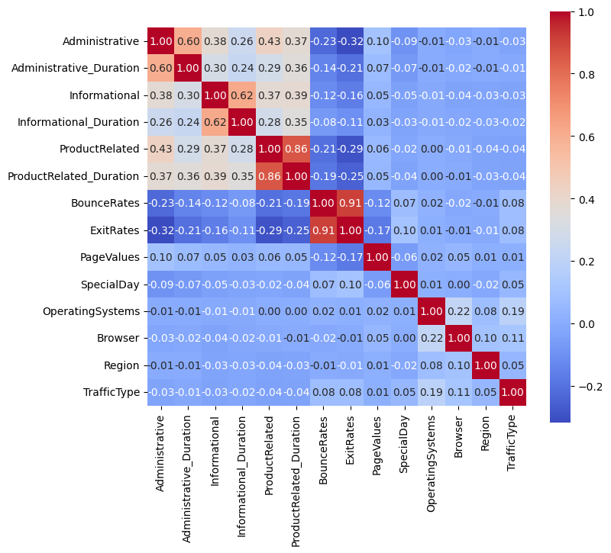
EXPLORATORY DATA ANALYSIS
1) Administrative vs Administrative_Duration,
Informational vs Informational_Duration,
ProductRelated vs ProductRelated_Duration:
Higher engagement in administrative, informational, and product-related sections of a website correlates with longer time spent in these areas, driven by complex tasks, relevant information, and in-depth exploration, as indicated by correlations of 0.60, 0.62, and 0.86, respectively.
2) BounceRates vs ExitRates shows a strong positive correlation of 0.91 which suggests that when bounce rates are high (users leave after viewing a single page), exit rates are also typically high.
3) OperatingSystems vs Browser show a correlation of 0.22 which suggests a mild relationship between the type of operating system and browser. Some browsers might be more popular on specific operating systems.

Slide 6
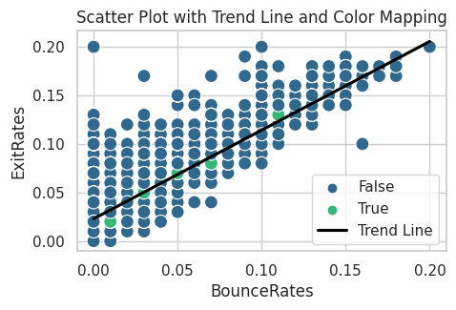
EXPLORATORY DATA ANALYSIS
The upward-sloping trend line showing a positive correlation between BounceRates and ExitRates, coupled with transactions clustering near this line, indicates that transactions are more likely to occur in scenarios where these two rates are aligned. This pattern suggests a predictable relationship between user engagement metrics and transaction likelihood.

Slide 7
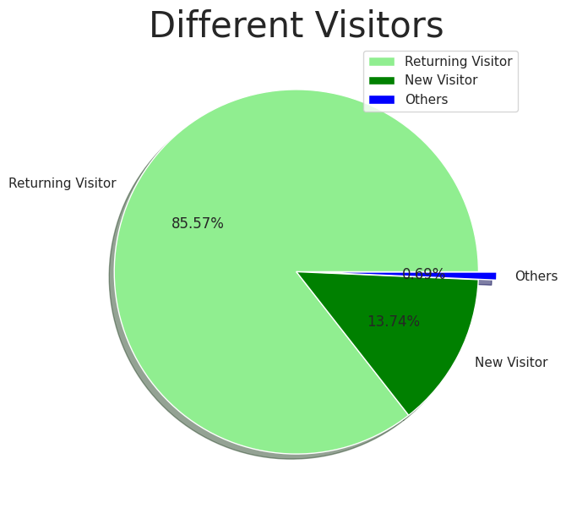
EXPLORATORY DATA ANALYSIS
Returning Visitor (85.57%): This large green segment represents the majority of visitors, indicating that they are repeat visitors who have previously accessed the site.
New Visitor (13.74%): This smaller section, although significantly less than the returning visitors, represents those who are visiting the platform for the first time.
Others (0.69%): The smallest segment, labeled "Others," likely includes visitors who don't fit into the "Returning" or "New" categories. This might include bots, users not tracked due to disabled cookies, or any other group not easily classified.

Slide 8
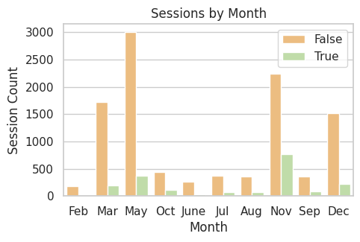
EXPLORATORY DATA ANALYSIS
The bar chart depicts the count of sessions by month, divided into two categories: 'True' (shown in green) and 'False' (shown in beige). The term 'sessions' typically refers to interactions or visits to a website.
Overall, sessions fluctuate month by month, with certain months seeing higher activity.
May and November stand out with the highest number of sessions, primarily falling under the 'False' category.
While most months have a predominant number of 'False' sessions, the ratio of 'True' sessions is comparatively smaller.
June and September show the lowest overall sessions, with June having very minimal 'True' sessions.

Slide 9
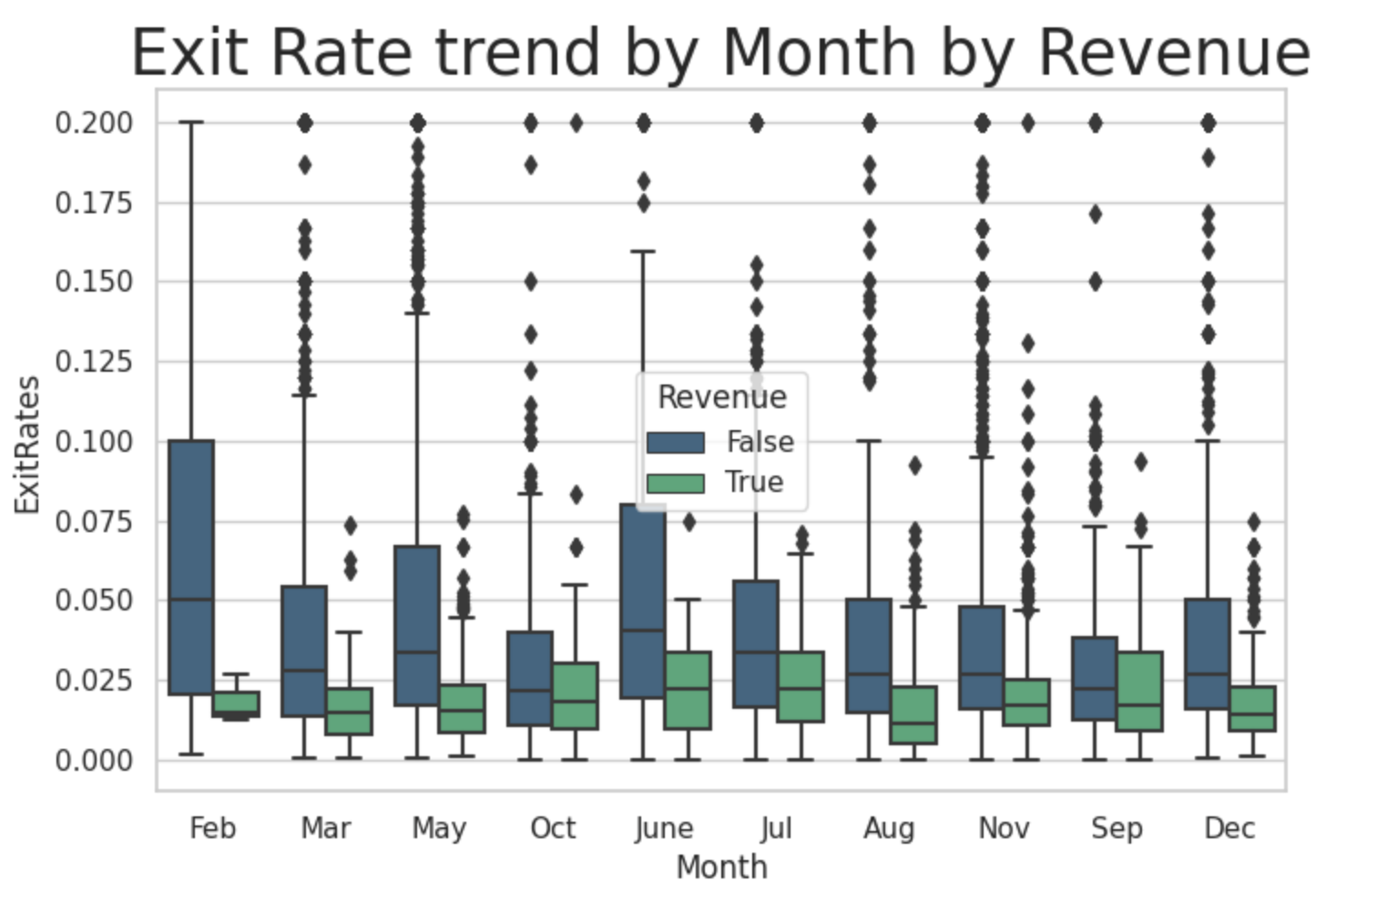
EXPLORATORY DATA ANALYSIS
The image displays a box plot titled "Exit Rate trend by Month by Revenue" for different months. Blue boxes represent non-revenue sessions with generally higher exit rates, while green boxes represent revenue sessions with lower exit rates. The chart shows monthly exit rate trends, with notable higher medians in June and October for revenue and non-revenue sessions, respectively, and several outliers indicated by diamonds above and below the boxes.

Slide 10
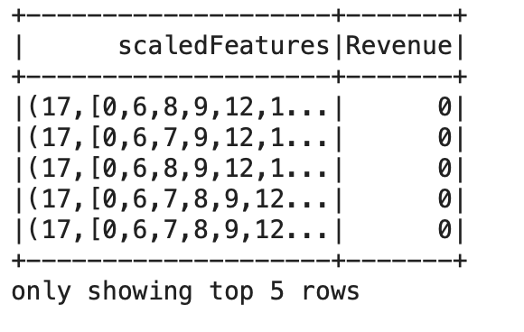
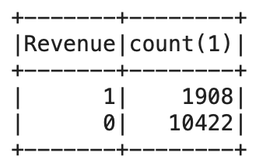
FEATURE ENGINEERING
Boolean columns are converted to integers for use in a machine learning model.
Categorical features are numerically indexed.
A feature vector is created by assembling both categorical and numerical features.
Features are standardized using a scaler.
The resulting DataFrame shows the top 5 rows with a 'scaledFeatures' vector and a binary 'Revenue' target, ready for use in predictive modeling.
Data analysis reveals 1,908 instances with 'Revenue' = 1 and 10,422 with 'Revenue' = 0, highlighting class distribution.

Slide 11
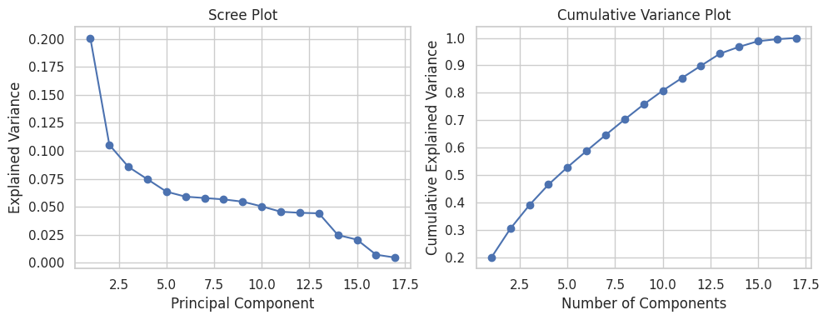
Shoppers Segmentation using PCA and K-Means Clustering
PCA
Used PCA for Dimensionality Reduction, simplifying the data, reducing noise, and possibly improving our clustering.
The scree plot explains the variance by each principal component. It helps in determining the number of components to retain.
The cumulative variance plot shows the total variance explained by the first 'n' components.
Based on our plots, we chose 10 components which cover 80% of the total variance.

Slide 12
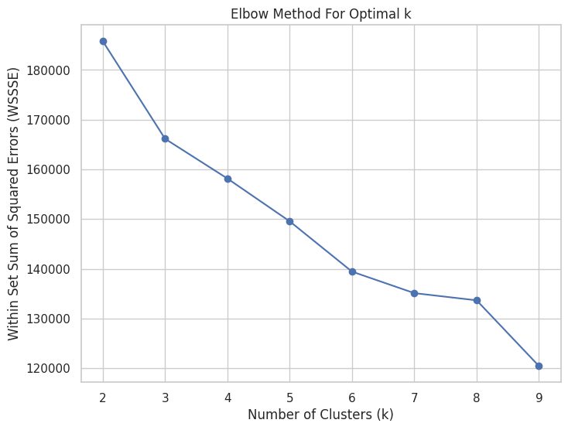
Elbow Method for K-means – WSSSE (Within Set Sum of Squared Errors)
To determine the Optimal number of clusters (Chose k = 4)
After 4, the variance decreases and smaller tighter clusters will cause overfitting which we need to avoid.

Slide 13
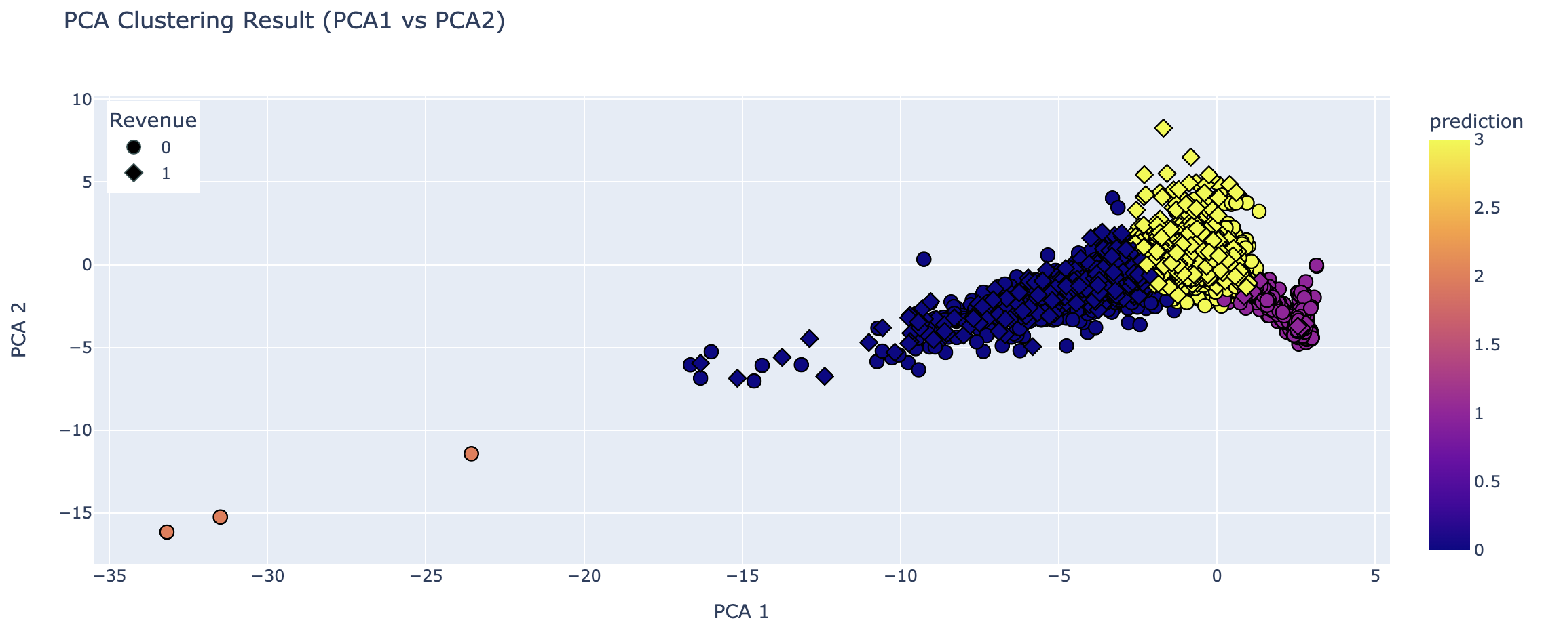
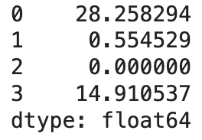
K-Means Clustering (PCA1 VS PCA2)
We see that Cluster 0 has the highest percentage of sessions (28.25%) which resulted in a complete transaction which in turn contributed to the revenue of the website.

Slide 14
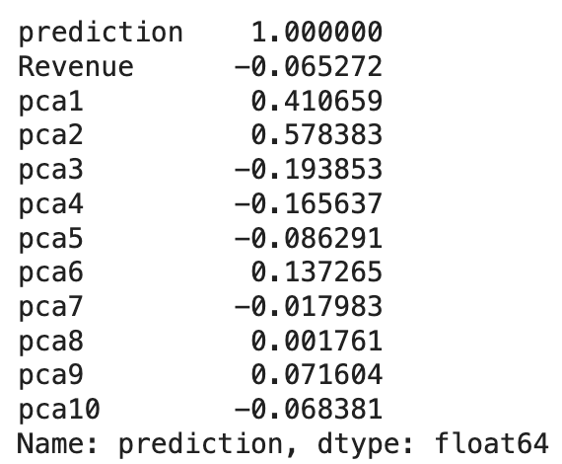
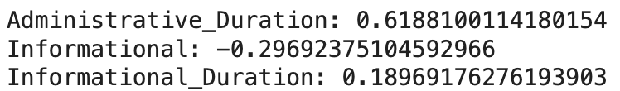
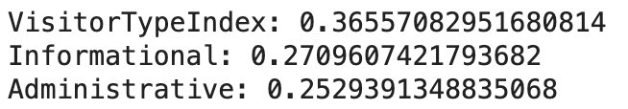
PCA Correlation with Clusters and Most Impactful (Key) Features
The prediction column shows a strong positive correlation with pca2 (0.578383), and a moderate positive correlation with pca1 (0.410659).
This indicates that PCA2 is most influential in the formation of the clusters, followed by PCA1.
Features like Administrative_Duration and Informational have high absolute loadings. This means that these features are the most influential in defining the variance captured by PCA1
VisitorTypeIndex, Administrative, and Informational have significant loadings on PCA2. Their contribution influences how data points are spread out on the PCA2 axis.

Slide 15
PREDICTION AND INFERENCE GOALS
The project aims to predict whether a session will result in revenue on a website, which is a binary classification task.
The inference objective is to understand which model best predicts revenue generation and to interpret the model's performance metrics.

Slide 16
INTERESTING/SURPRISING RESULTS
Gradient Boosting Trees (GBT) have the highest AUC score, suggesting they perform best in balancing the true positive rate against the false positive rate.
Logistic Regression, despite being a simpler model, shows competitive performance with an AUC close to that of the more complex Random Forest model.

Slide 17
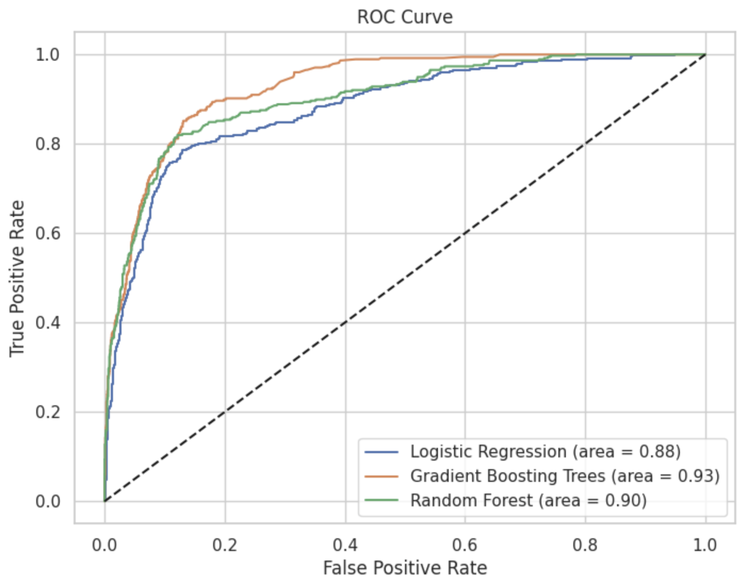
SUMMARY OF METHODS USED
Three machine learning models were trained and tested: Logistic Regression (LR), Gradient Boosting Trees (GBT), and Random Forest (RF).
The models were evaluated using multiple metrics: AUC, accuracy, precision, recall, and F1 score.
An ROC curve was plotted to visualize the performance of each model.

Slide 18
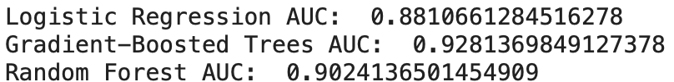
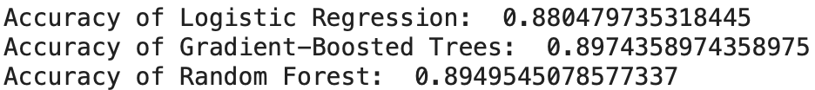
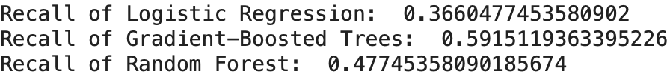
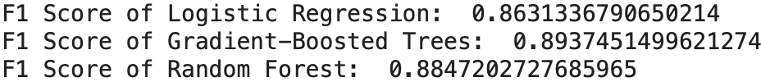

RESULTS SUMMARY
LR showed an AUC of 0.881, accuracy of 0.880, precision of 0.730, recall of 0.366, and F1 score of 0.861.
GBT had an AUC of 0.921, accuracy of 0.897, precision of 0.703, recall of 0.592, and F1 score of 0.839.
RF resulted in an AUC of 0.902, accuracy of 0.895, precision of 0.759, recall of 0.477, and F1 score of 0.884.

Slide 19
SUMMARY OF ACHIEVEMENT OF OUR GOALS
The features that most influence PCA1 and PCA2, as shown by their loadings, are VisitorTypeIndex, Administrative, Administrative_duration, and Informational.
Since PCA1 and PCA2 is highly correlated with the clusters, these features are likely pivotal in determining the cluster with the highest revenue conversion. Hence, focusing on strategies that leverage these aspects of customer engagement could be key to driving higher revenue.
GBT leads in AUC, a critical metric for imbalanced classes, which indicates a strong predictive ability. We consider Recall to compare our models as we are more interested in predicting revenue generating sessions.
LR, while having the lowest recall, maintains strong performance in AUC and F1, indicating good model performance despite its simplicity.

